Slide 1
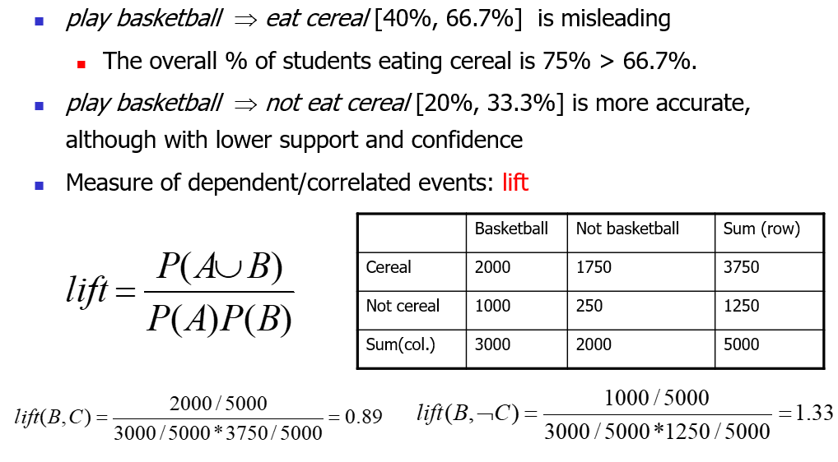
Lift

Slide 2
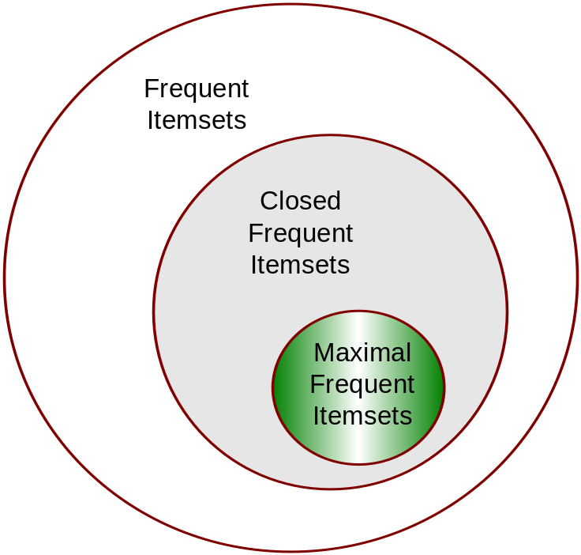
Maximal vs Closed Frequent Itemsets
An itemset X is a max-pattern if X is frequent and there exists no frequent super-pattern Y כ X
An itemset X is closed if X is frequent and there exists no super-pattern Y כ X, with the same support as X

Slide 3
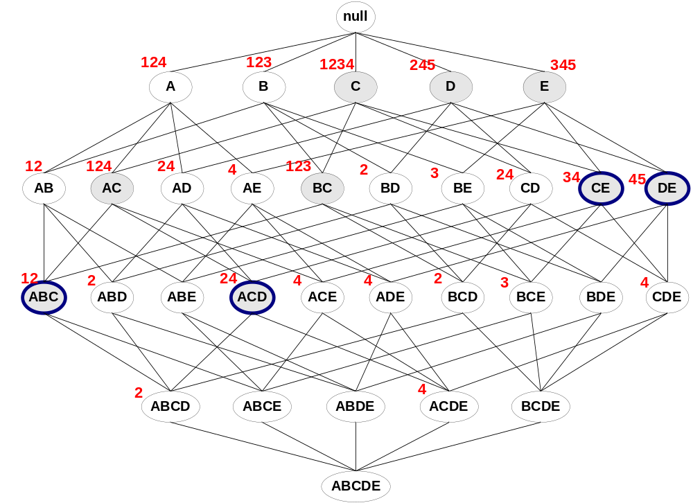
Maximal vs Closed Frequent Itemsets
Closed but not maximal
minsup=2
Closed and maximal frequent
# Closed = 9
# Maximal = 4

Slide 4
Use of Association Rules:
Classification
Classification: mine a small set of rules existing in the data to form a classifier or predictor.
  It has a target attribute (on the right side): Class attribute
Association: has no fixed target, but we can fix a target.

Slide 5
Class Association Rules (CARs)
Mining rules with a fixed target
  Right-hand-side of the rules are fixed to a single attribute, which can have several values
  E.g., X = a, Y = d → Class = yes
  X = b → Class = no
Call such rules: class association rules

Slide 6
Mining Class Association Rules
Itemset in class association rules:
<condset, class_value>
condset: a set of items
item: attribute value pair, e.g.,
attribute1 = a
class_value: a value in class attribute

Slide 7
Classification Based on Associations (CBA)
Two steps:
Find all class association rules
  Using a modified Apriori algorithm
Build a classifier
  There can be many ways, e.g.,
    Choose a small set of rules to cover the data
Numeric attributes need to be discrertized.

Slide 8
Advantages of the CBA Model
Existing classification systems use
  Table data.
CBA can build classifiers using either
  Table form data or
  Transaction form data (sparse data)

